Slide 1
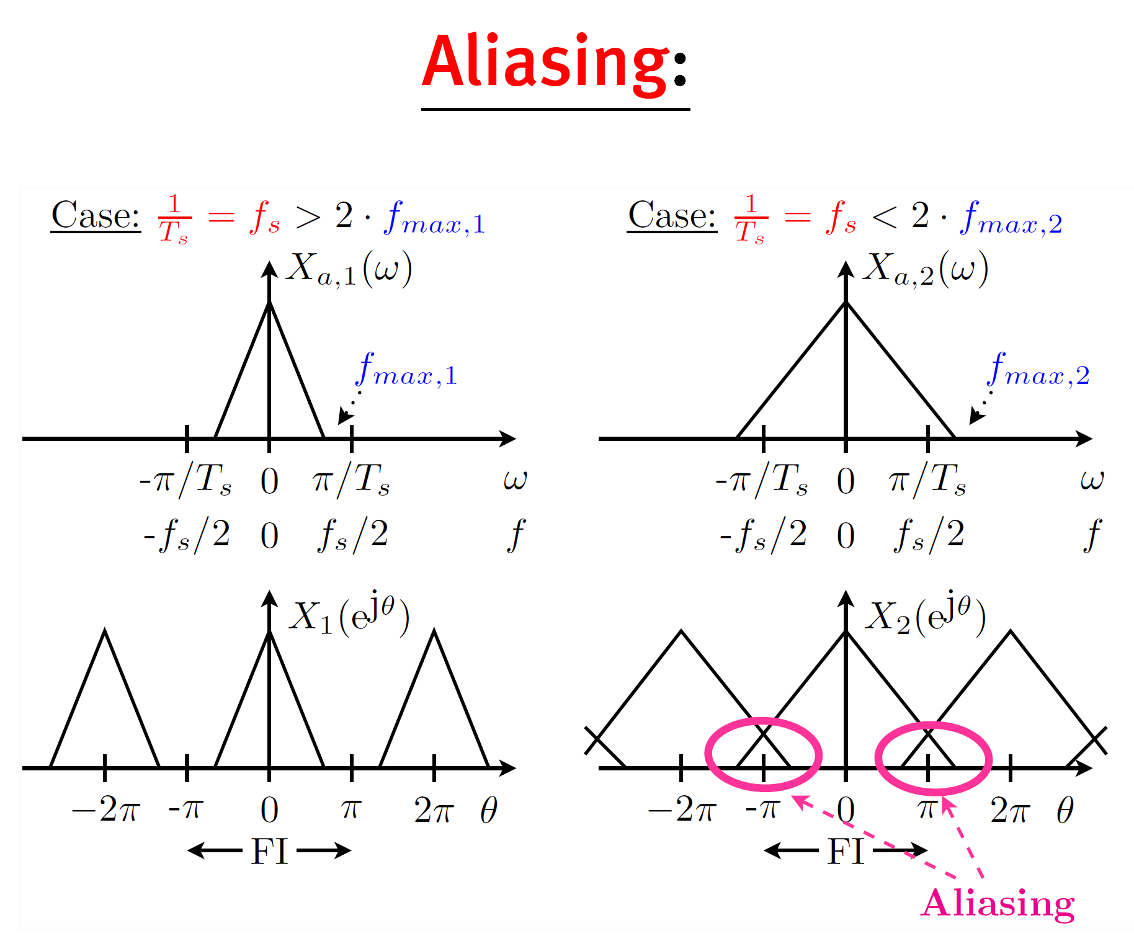
C/D conversion

Slide 2
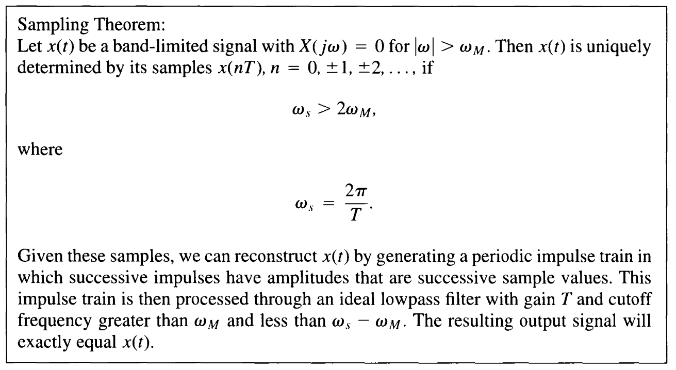
C/D conversion
Shannon Sampling Theorem

Slide 3
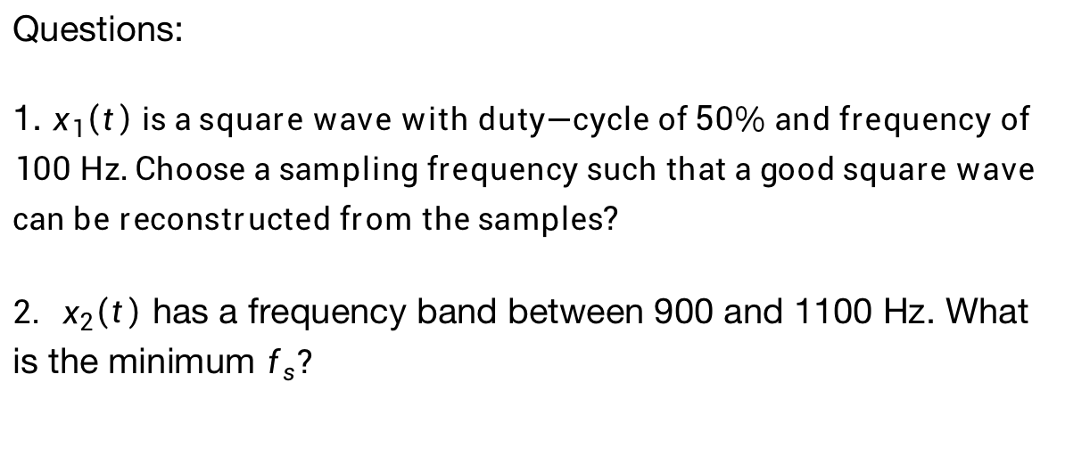
C/D conversion
Shannon Sampling Theorem
Questions:
1. $x_{1}\left(t\right) \text{is} \text{a} \text{square} \text{wave} \text{with} \text{duty}\text{−}\text{cycle} \text{of} \text{50}\text{\% }\text{and} \text{frequency} \text{of} \text{100} \text{Hz}\text{. }\text{Choose} \text{a} \text{sampling} \text{frequency} \text{such} \text{that} \text{a} \text{good} \text{square} \text{wave} \text{can} \text{be} \text{reconstructed} \text{from} \text{the} \text{samples}\text{?}$
${2. x}_{2}\left(t\right)$ has a frequency band between 900 and 1100 Hz. What is the minimum $f_{s}?$

Slide 4
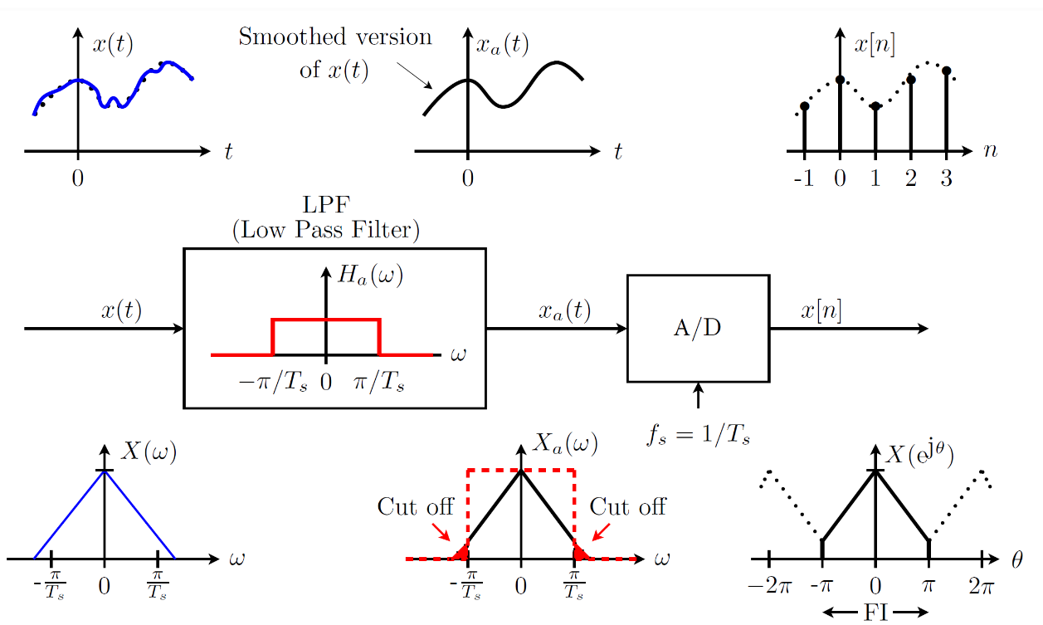
C/D conversion
Practice: Analog LPF needed in A/D Conversion
Theory : C/D; Practice : A/D

Slide 5
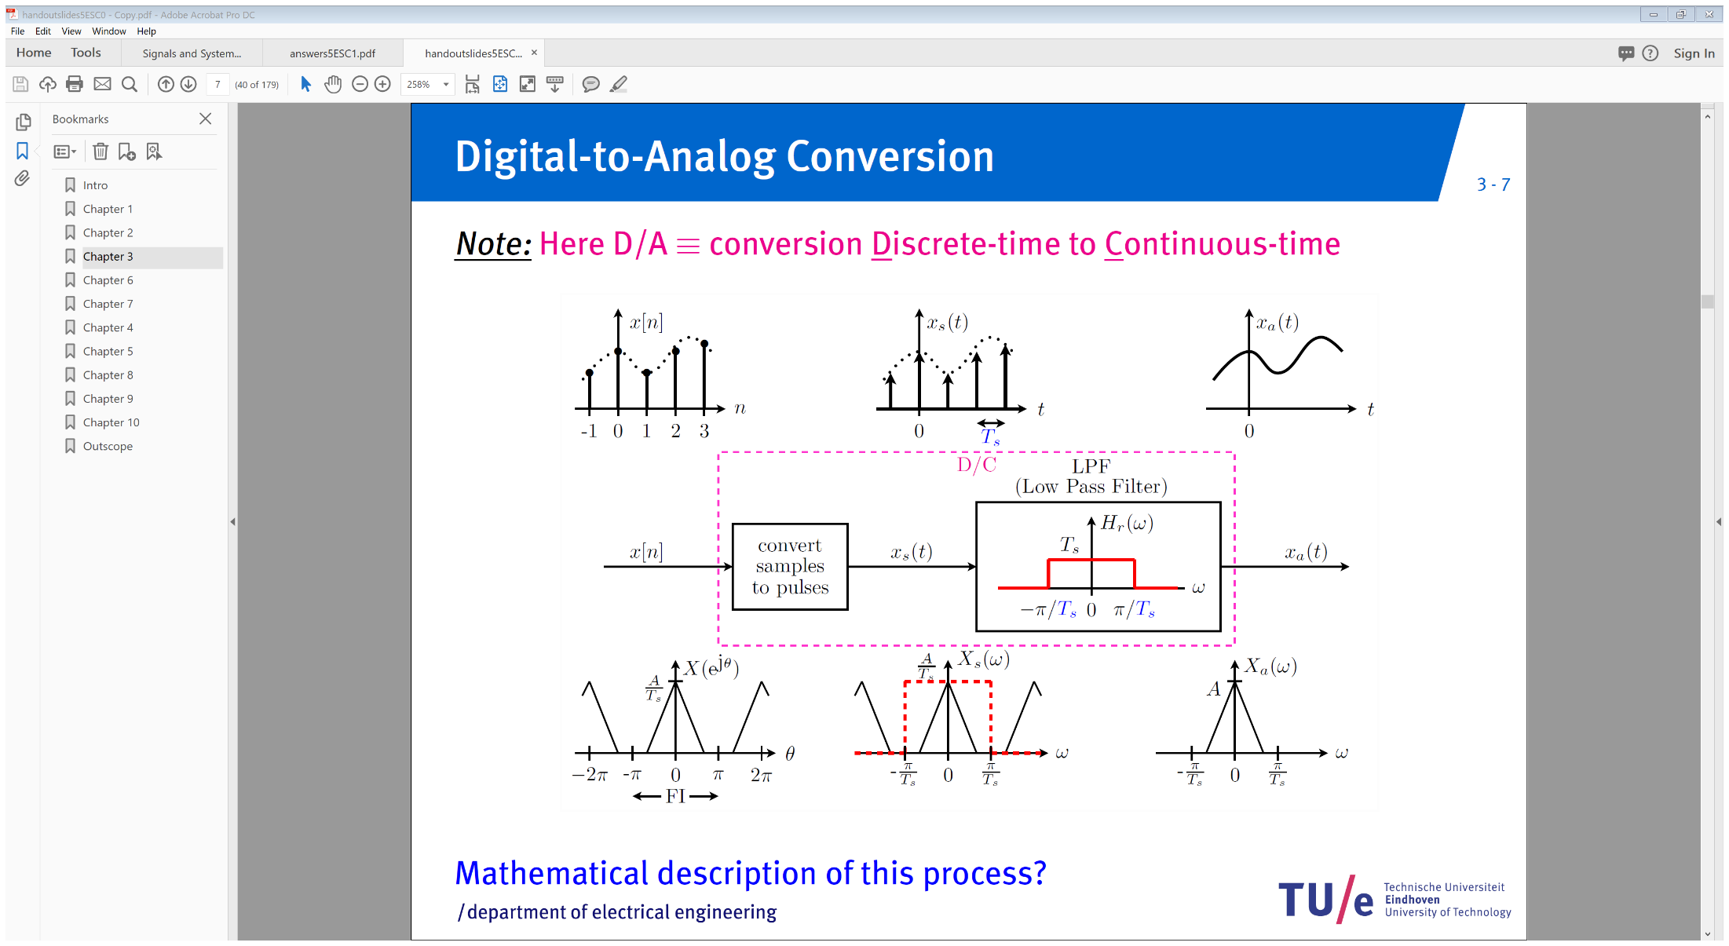
D/C conversion

Slide 6
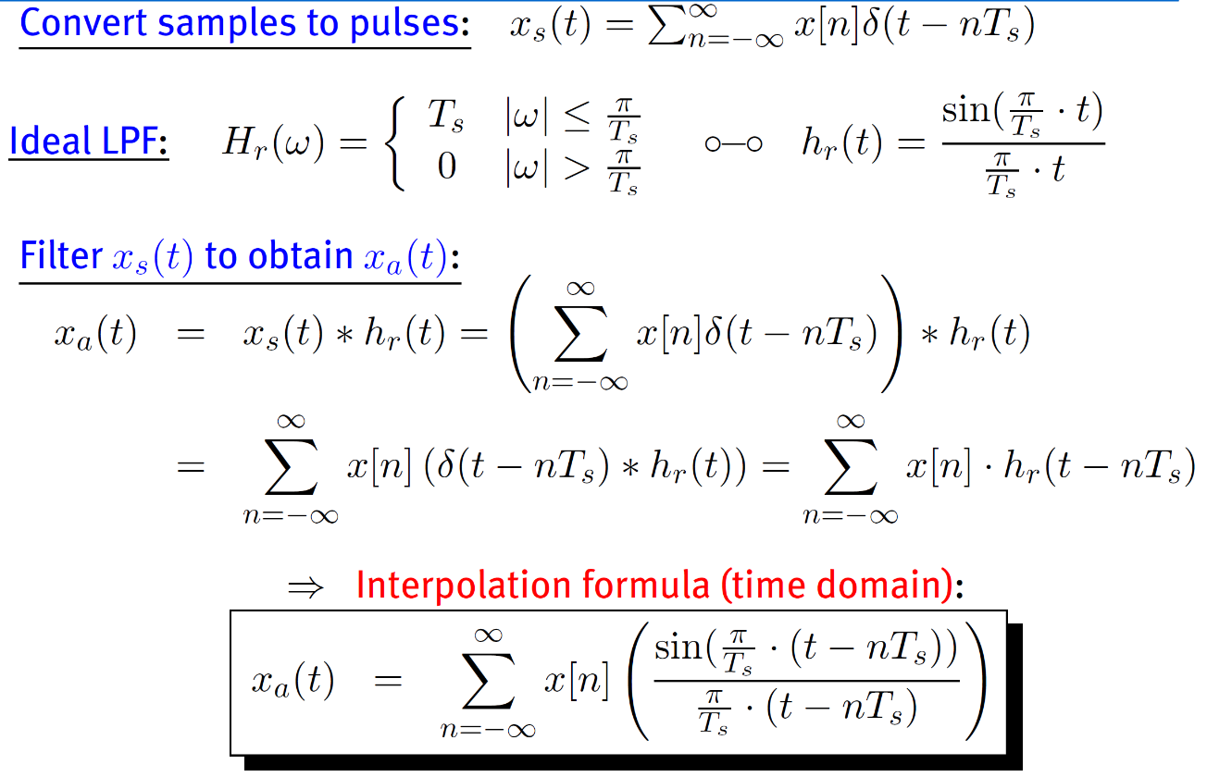
D/C conversion

Slide 7
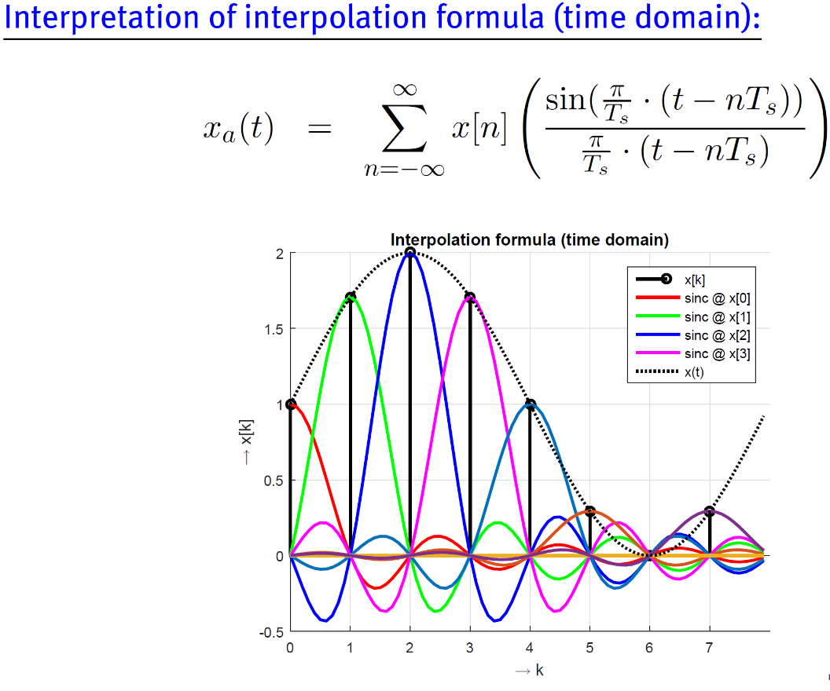
D/C conversion

Slide 8
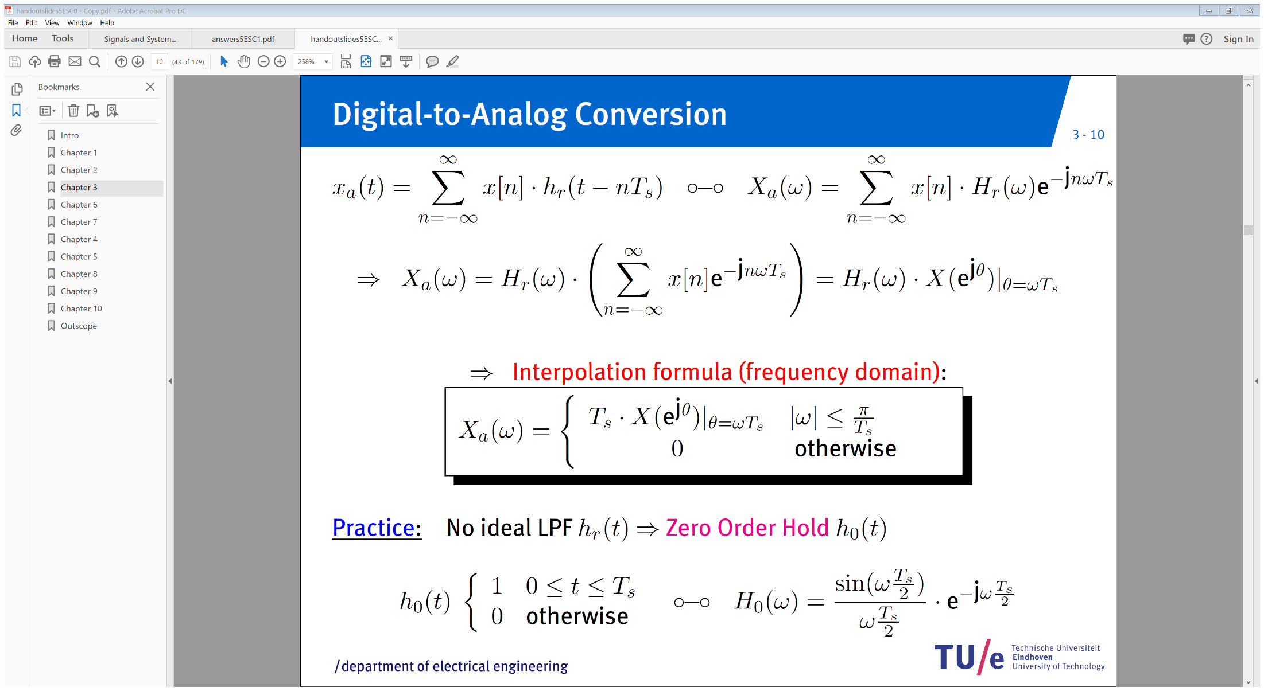
D/C conversion
Frequency domain

Slide 9
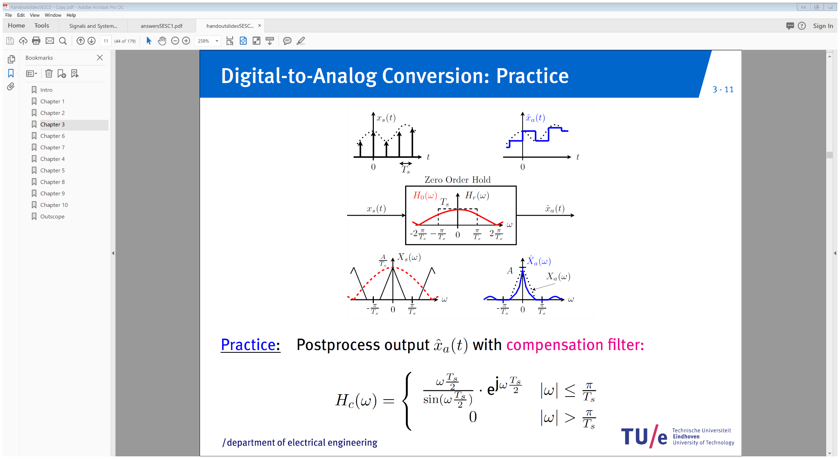
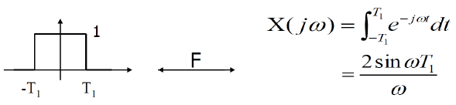


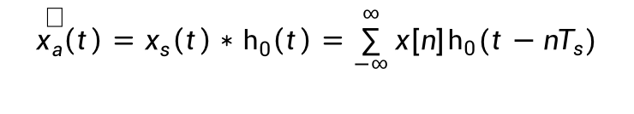




D/C conversion
$${\hat{x}}_{a}\left(t\right)=x_{s}\left(t\right)∗h_{0}\left(t\right)=\sum_{−∞}^{∞}{x[n]h_{0}\left(t−nT_{s}\right)}$$
$$h_{0}(t)$$
$$1$$
$$t$$
$$0$$
$$T_{s}$$
$$H_{0}\left(ω\right)=T_{s}\frac{\sin{(ω\frac{T_{s}}{2})}}{ω\frac{T_{s}}{2}}e^{−jω\frac{T_{s}}{2}}$$

Slide 10
D/C conversion

Slide 11
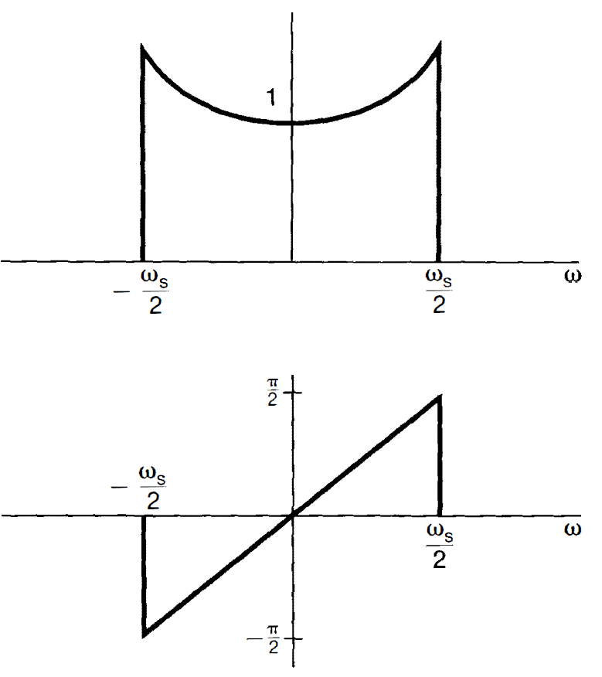
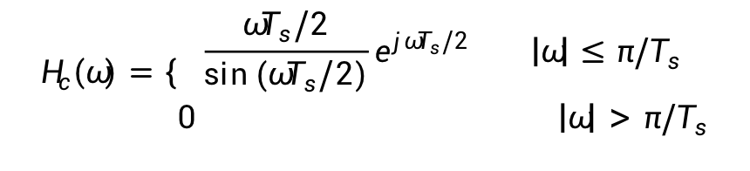


D/C conversion
$$H_{c}\left(ω\right)=\left\{\begin{matrix}\frac{ωT_{s}/2}{\sin{(ωT_{s}/2)}}e^{jωT_{s}/2} \left|ω\right|≤{π/T}_{s} \\ 0 \left|ω\right|>{π/T}_{s}\end{matrix}\right.$$
${|H}_{c}(ω)$|
$$H_{0}\left(ω\right)H_{c}\left(ω\right)=H_{r}\left(ω\right)=T_{s}, |ω|≤π/T_{s}$$
$$H_{0}\left(ω\right)=T_{s}\frac{\sin{(ω\frac{T_{s}}{2})}}{ω\frac{T_{s}}{2}}e^{−jω\frac{T_{s}}{2}}$$
$${∠H}_{c}(ω)$$
Once again, cannot be realized!

Slide 12
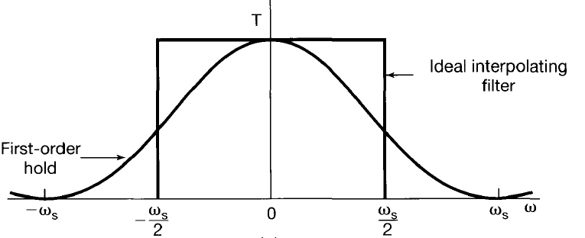




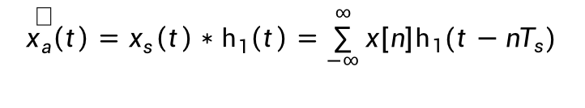
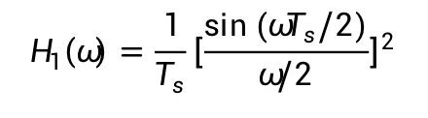
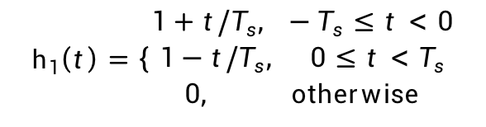
D/C conversion
First order hold
$${\hat{x}}_{a}\left(t\right)=x_{s}\left(t\right)∗h_{1}\left(t\right)=\sum_{−∞}^{∞}{x[n]h_{1}\left(t−nT_{s}\right)}$$
$${\hat{x}}_{a}(t)$$
$$t$$
$$0$$
$$T_{s}$$
$$h_{1}(t)$$
$$1$$
$$h_{1}\left(t\right)=\left\{\begin{matrix}1+t/T_{s}, −T_{s}≤t<0 \\ 1−t/T_{s}, 0≤t<T_{s} \\ 0, otherwise\end{matrix}\right.$$
$${−T}_{s}$$
$$t$$
$$0$$
$$T_{s}$$
$$H_{1}\left(ω\right)=\frac{1}{T_{s}}{\left[\frac{\sin{(ωT_{s}/2)}}{ω/2}\right]}^{2}$$

